Slide 1
Create Bid
Applicable roles:
Health Board user
Regional Co-ordinator

Slide 2
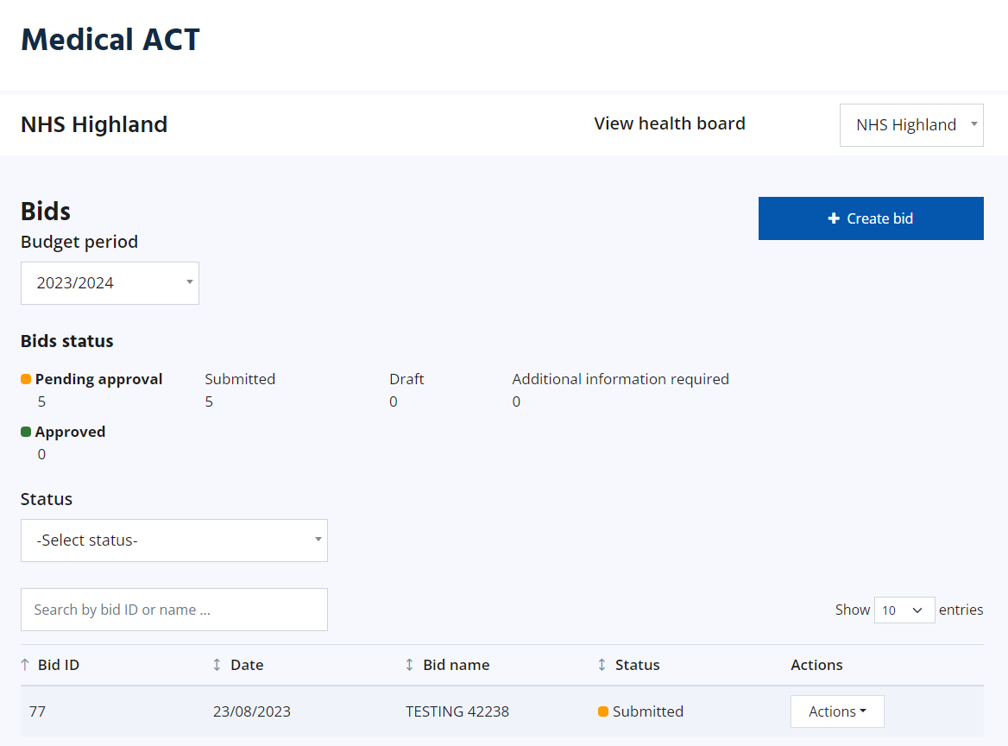
Create Bid
Users can create a bid from the ACT landing page. If the user has multiple Health Boards, they should ensure they are viewing the correct Health Board first, then create the bid.

Slide 3
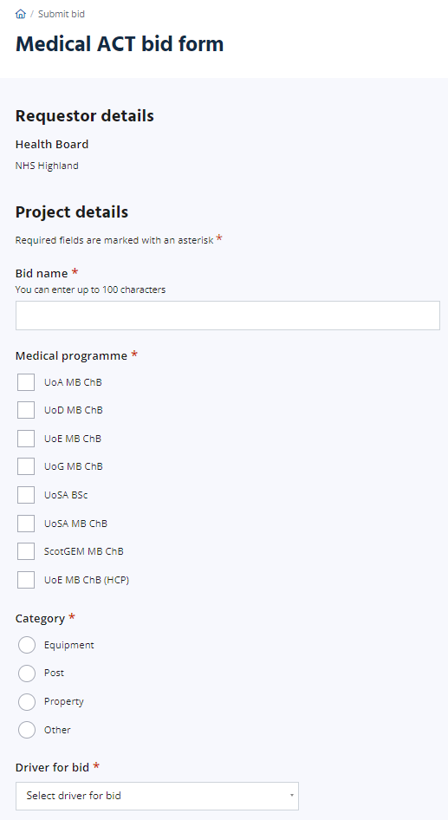
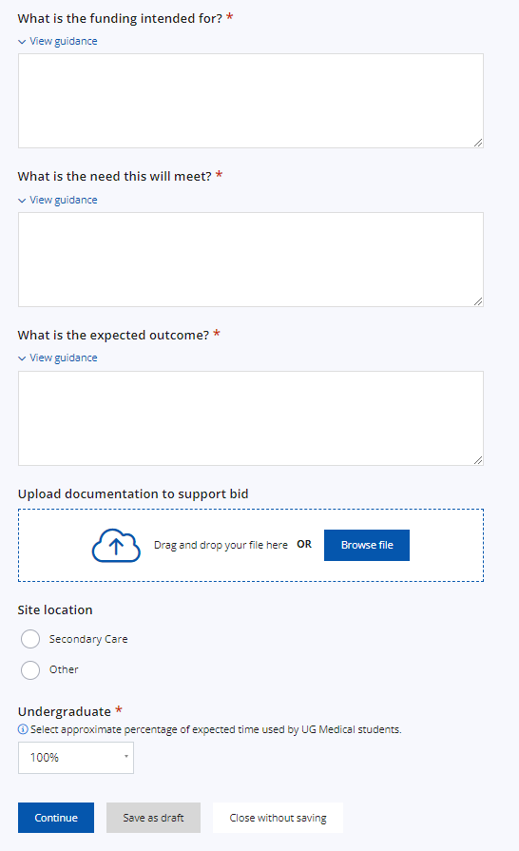
Create Bid – Project Details
The user will be taken to the Medical ACT bid form where they can complete the form with the Project details.
The Driver for bid dropdown gives the following options:
Increase in student numbers
Curriculum changes
Replacement of equipment
Department/Clinical teaching feedback
Student feedback
Student wellbeing
Other (if this is chosen, a free text box will appear)
Once this form is complete, the user can Continue to the Costing page, save the form as draft, or close the form without saving.
Pre-populated based on which Health Board the user was viewing on the homepage.
When Secondary Care is selected, the user will be able to select the location from a dropdown. Where Other is selected, a free text box will appear.
Selecting a category will provide sub-categories to choose from (details on next slide)

Slide 4
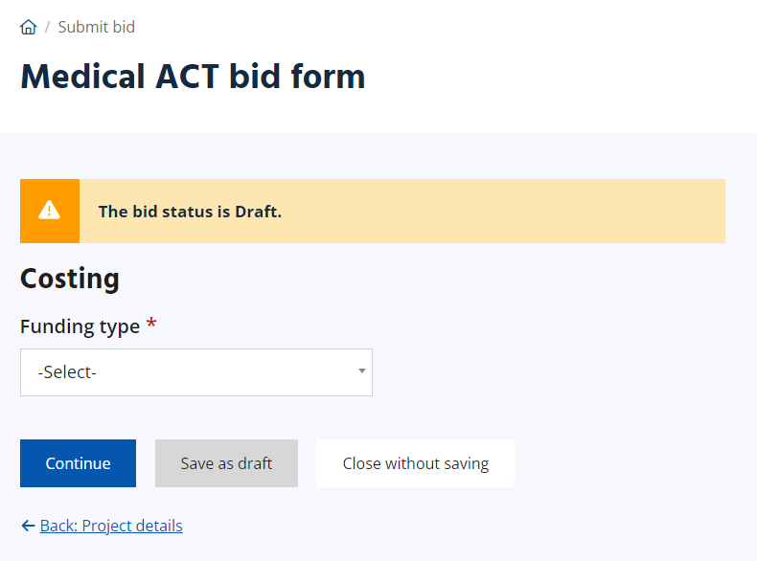
Create Bid – Costing Overview
The Costing page allows the user to select the funding type from the dropdown. The available options are:
Post GP teaching (top sliced)
Post recurrent
Post non recurrent (time limited)
Student T & A
Other recurrent
Other non recurrent (time limited)
If your bid has separate elements with different funding types, separate bids will need to be submitted.

Slide 5
Selecting funding Type
If required in future years will spend be included in MoT return as top-sliced cost
Yes
No
Is the cost for student expenses
Is cost recurrent (Permanent funding request)
Yes
No
Yes
No
Student T&A
Post GP teaching
Is it for a post/s
Is it for a post/s
Yes
No
Yes
No
Post recurrent
Other recurrent
Post
non-recurrent
Other
non-recurrent

Slide 6
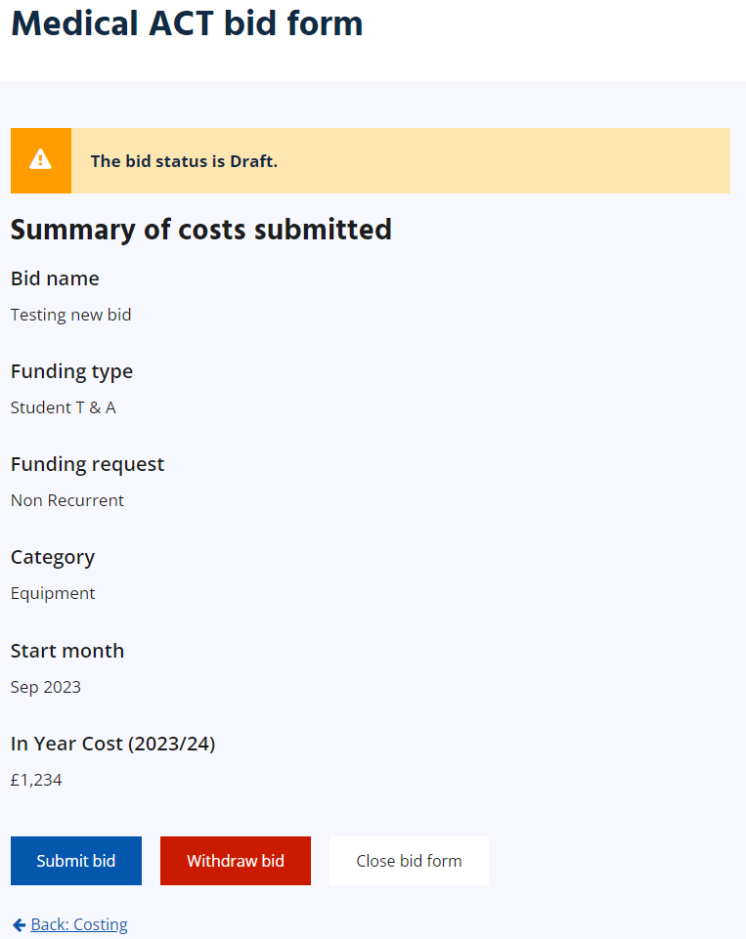
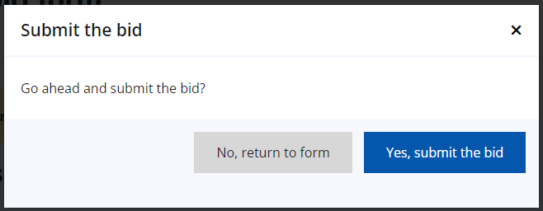
Create Bid – Summary page
Once the costing page is complete, and Continue is selected, the user will be taken to a summary page which gives an overview of the inputted information.
If details need to be amended, the user can use the Back button at the bottom of the page.
The user can then submit the bid if ready, withdraw it, or close the bid form (this will keep it saved as a draft).
On clicking to submit the bid, the user will be asked to confirm submission.

Slide 7
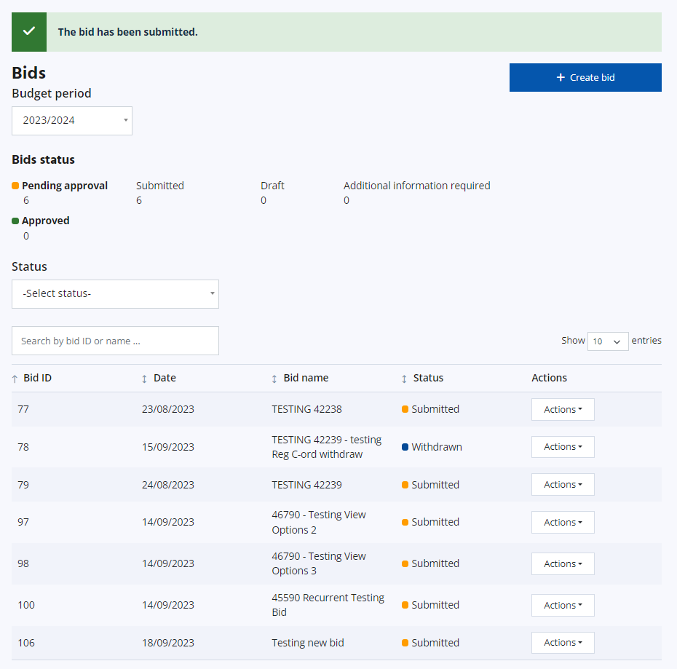
Create Bid –Submitting the bid
The user will be taken back to the landing page where a green alert will confirm the bid has been submitted.
The bid is also now displaying in the bid summary table with an automatically-assigned Bid ID.

Slide 8
Information for Bids
If a field has an Asterix this indicates a mandatory field, and you will not be allowed to submit the bid without completing.
The Reference will be generated by the APP. This is not individual to Health Boards but sequential as bids are submitted and will increase year on year.
Bid Name – 100 characters. If you wish to include a local reference this can be included in the name to allow you to search by it on the landing page.
*What is the funding intended for? (1,000 characters) This should include a concise background and summary of the situation.
*What is the need this will meet? (600 characters) This should highlight the identified gap and how this will be met.
*What is the expected outcome (250 characters) This should include how the bid fulfils the need and details of any evaluation.
Bullet points may be helpful for the above. If the bid is complex additional information can be attached for example a job specification or project plan.
The Site location secondary care has a list taken from the annual Quality Report locations. If you start typing the location a list of options will become available to choose from. NES Admin can add additional locations for future use, please email Medical ACT mailbox.
Primary Care locations can be added by free text
Undergraduate % - increments of 10 – Please pick closest match

Slide 9
Information for Bids
In-year cost – cost for the current/first NHS financial year i.e. April-March.
Recurrent bids - the in-year cost might be lower than the recurrent costs as there will only be part-year spending for the first year,
e.g. 1 WTE band 7 clinical skills lead 24/25 only 8 months £48k recurrent amount £72k, £72k will be added to following years baseline position.
Non-recurrent bid – should reflect the current year costs only
Future year cost – only available for non-recurrent bids this allows for multi-year bids to be placed and funding approved
e.g. accommodation block refurb current year £250k, future year 1 £60k
Breakdown of costing 250 characters – this should detail the spend eg 10 laptops at £1000 ea, 5 smart screens £10k ea,

