Slide 1
My Career Journey
Dr Samira Bell
Clinical Reader & Consultant Nephrologist
University of Dundee

Slide 2
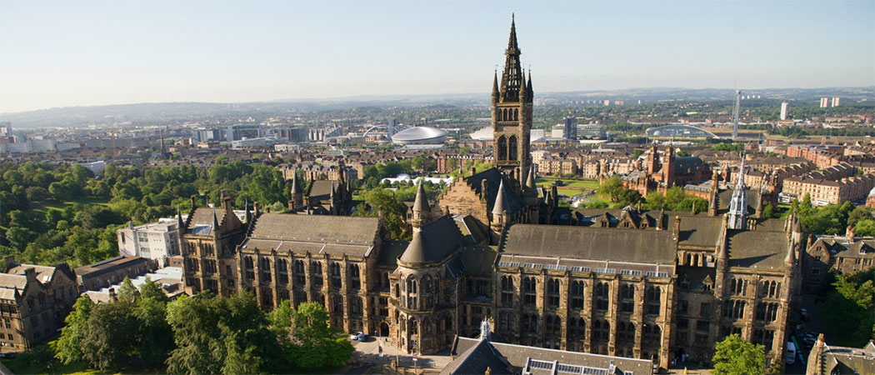
1994-1999
University of Glasgow: MBChB
1999-2003
2003-2005
Medical rotation
Clinical Research Fellow, University of Glasgow
2009: Maternity leave
2010
2005-2010
Consultant Nephrologist Ninewells, Dundee
Nephrology Training
2014
NRS Fellowship
2015: Maternity leave
2019 -2023
Senior Clinical Lecturer & Honorary Consultant Nephrologist
Clinical Reader
2023 -present

Slide 3
Benefits
Variation in work (different roles)
Tailored job to suit my interests
Travel
Meeting/ working with different people
No on call!
Challenging
Interesting

Slide 4
Difficulties encountered along the way
Repeated rejection
Establishing research environment
Maternity leave/ part time working
Constant juggling- clinical work/ research/ teaching/ family
Guilt
Imposter Syndrome

