Slide 1
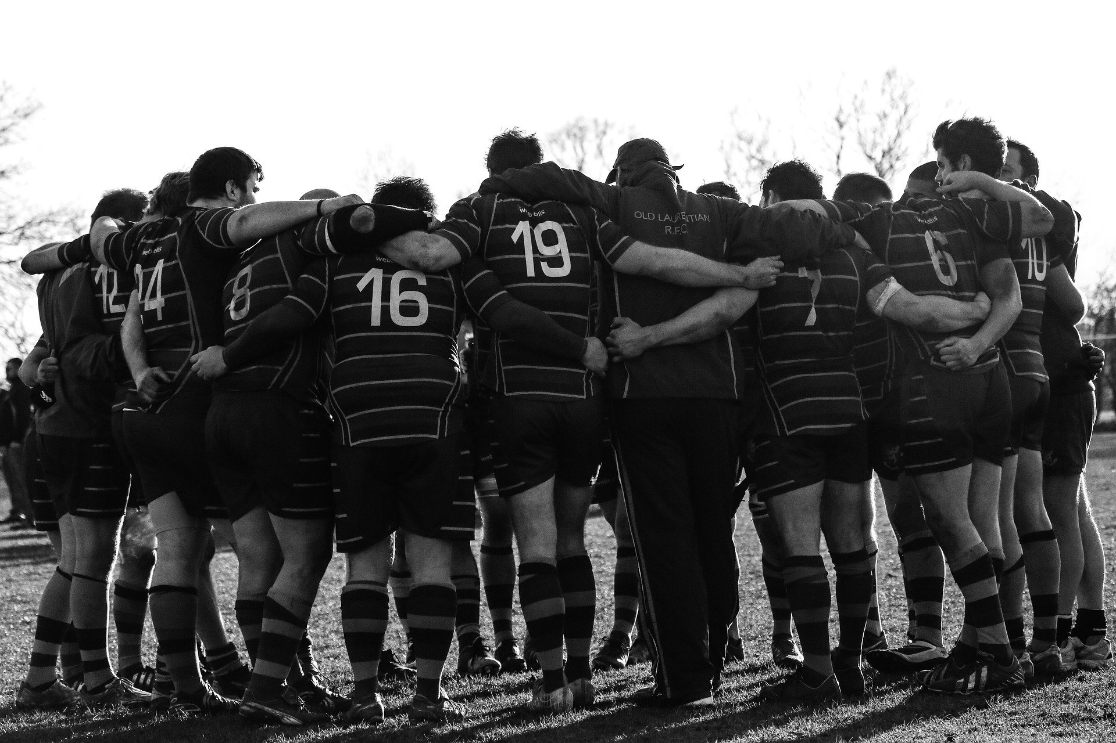
Scottish Practice Management Development Network
Teamwork and Communication:
It’s all in a Huddle
Notes:
Good afternoon and Thank you,
So for todays final session we will look at team huddles and how they can support practices and their teams .

Slide 2
What are huddles?
Why huddle?
Case studies
Tips to start huddles
Overcoming challenges
Notes:
We will look at what a huddle is, why we might huddle, we’ll look at some examples of how practices are using huddles and finally we’ll share some top tips for huddling and overcoming some common challenges.

Slide 3
Short, snappy
Gathering of team
High interactive style
Notes:
The huddle concept is not new, they can take a variety of formats and are used for a variety of purposes but in general it is a short, snappy meeting lasting no more than 10-15 minutes. And ideally 5-10 minutes.
The morning huddle is not for reporting to a team leader. It’s a check-in so that team members can communicate with each other, pull together and know what each other is working on., hence it’s highly interactive style.
Huddles can give you an opportunity to recognize problems from yesterday’s work, anticipate problems for today’s work, and check on the status of ongoing work while enabling teams to coordinate and share information quickly across the practice. They can help to improve or maintain operational efficiency but can also be used to also bring up more personal news such as birthdays, engagements, births, passing driving tests and sometimes sad news.
These short meetings usually follow a standard agenda or format and this will be dependant on your team and the objective of the huddle.
When the COVID pandemic first hit Scotland, many GP practices started to have daily huddles. At this time, guidance was changing rapidly and huddles allowed teams to share safety critical information and consider issues such as staff numbers, appointment availability and provide support to team members and we’ll see some examples of this soon.

Slide 4
Focus – on key goals
Clarity – clear, relevant and timely information to help teams perform their daily roles
Commitment – to listen to & act on staff views, ideas, concerns and to feedback progress
Notes:
In general though huddles have a clear focus,
Provide clear relevant and timely information which in turn helps teams perform their daily roles
And rely on a commitment to listen to and act on team members views, ideas and concerns and to provide feedback on progress.

Slide 5
Communication
Patient Safety
Employee engagement
Celebrate
Notes:
So why huddle?
Huddles have been shown to improve communication, patient safety and staff satisfaction in primary care.
Most importantly, a team with greater cohesiveness has been shown to produce better clinical outcomes and higher patient satisfaction.
They also provide an opportunity for teams to share and celebrate milestones and success

Slide 6
We hope to encourage other organisations to set up similar morning huddles to improve teamwork and communication. The time spent together is invaluable, not just for improving technical
aspects of the job, and thereby helping to improve patient safety, but also for building and nurturing relationships within the practice.
Dr Jillian Denovan
How our morning ‘huddles’ improved
practice teamworking. Pulse July 2018
Notes:
This is a quote from Dr Gillian Denovan a GP at Pathfields Medical group in Plymouth which I think sums up the values of huddles.
She says that
We hope to encourage other organisations to set up similar morning huddles to improve teamwork and communication. The time spent together is invaluable, not just for improving technical aspects of the job, and thereby helping to improve patient safety, but also for building and nurturing relationships within the practice.
She goes on to say, that Dialogue and socialisation have possibly been undervalued in general practice in recent times due to work pressures, but these
are key to improving interpersonal communication and camaraderie, which brings more joy to the workplace.

Slide 7
Notes:
So, we’ve look at what a huddle is and why we would huddle, lets look at some examples of how practices are using huddles.
Our first video is from Dr Duncan McNab, Duncan is a GP in Ayrshire and an Assistant Director in Patient Safety here at NES.

Slide 8
Tain & District Medical Group
3 years
Improve communication
Daily 9am
Pre-covid – all
Now – 1 person from each team
Admin, Nursing, GP, Physio, Podiatry and Community nursing representatives
Responsible for sharing any information
Notes:
Thank you Duncan,
Our next case study is from Lorna Waddell, Lorna is an Advanced Nurse Practitioner Partner at Tain & District Medical Group
They introduced their huddle 3 years ago following a partnership change with the aim of improving communication following this change. Also the practice, had a number of new part time staff who they wanted to keep in the loop and to know what each other was doing.
Tain and district medical group hold a daily huddle, in the office at 9am, with all clinicians marked off the appointment book to allow them to attend. This hasn’t changed since before the pandemic, however the number of attendees has. It used to be that everyone working on that day attended, now due to covid and social distancing 1 person from each team attends. So admin, nursing, GP, physio, podiatry and community nursing all send representatives with the person attending the huddle from their team being responsible for sharing any information.

Slide 9
No standing agenda items
SBAR
Situation
Background
Assessment
Recommendation
Notes:
They don’t have standing agenda items, Lorna explained that this keeps each daily huddle fresh and new. They do however use S BAR to raise and discuss topics
Situation
Background
Assessment
Recommendation
This could be as simple as
S - NO MILK
B - NO ONE HAS REMEBERED TO BUY MILK
A - NEED MILK
R - NOMINATE PERSON TO GO BUY MILK

Slide 10
Hugely improved communication, things like everyone knowing if a team is short staffed or if someone isn’t feeling well etc. then we can support each other
Notes:
This is a quote from Lorna, huddles have hugely improved communication, things like everyone knowing if a team is short staffed or if someone isn’t feeling well, then we can support each other.
Lorna provided a lovely example of how this works in practice. At yesterday’s huddle it was raised as a safety issue that one GP had a lot of teams meetings, so because they all knew that, they could drop a cuppa in, check their column etc to support them.
When asked if they plan to continue to huddle post covid, their response was ‘very definitely’

Slide 11
Millhill Surgery
Start of pandemic
To disseminate information
Initially daily at 8:20am
Everyone in building
Word of mouth or added to daily diary
Notes:
Our third example is from Millhill surgery in Dunfermline.
Susan Hogarth, the practice manager and a partner at Millhill has provided the following information about their huddles.
Millhill introduced huddles at the beginning of the pandemic, they were introduced to disseminate information being sent to the practice on a daily basis.
Initially the huddles were held every day at 8.20pm however as less information and changes were being made, these reduced in frequency and are now held weekly.
Anyone who is in the building at that time attends the huddle and Susan has explained to me that administrative staff made a specific effort to arrive early for the huddles. The socially distanced huddles use the reception and the waiting room and for those unable to attend, information is shared by word of mouth or added to their daily diary.

Slide 12
Agenda
Covid updates
What’s going well
What’s not going so well
How can we make it better for patients and staff
Notes:
Agenda items are determined by need to update on COVID and includes discussion on what is going well, what’s going not so well, and how they can make it better for both patients and staff.

Slide 13
Communication improved and a feeling of worth by the staff being in a position to put forward their ideas and see them actioned.
Notes:
When we asked Susan what benefits they had seen? She reported that Communication had improved and that the staff had a feeling of worth by being in a position to put forward their ideas and then see them actioned.
Again, this practice plans to continue with huddles post covid

Slide 14
Notes:
Our final case study is from Dingwall Medical Group and Dr Miles Mack and practice manager Pauline Ogilvie will speak about their team huddles.

Slide 15
Standard format
Set time and location
Standard operating procedures
Keep them brief
Think about participants
Notes:
I’d like to thank all four practices for sharing how they use huddles, these have demonstrated how successful huddles can be in terms of improving safety, communication and team work.
So what are the keys to success
Know what you want to talk about,
use a standard format. Being clear about the purpose of the meeting will help you do this and help you to develop an agenda or checklist for your meeting. This format may change as you start to huddle to meet the changing demands of the huddle.

Slide 16
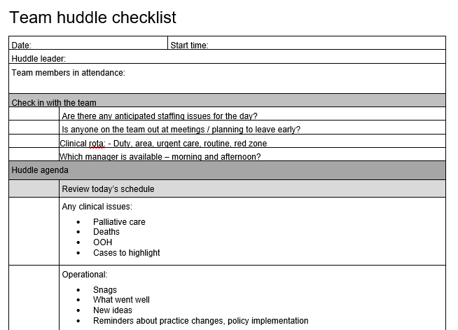
Notes:
This is the checklist that Dingwall Medical Group use for their huddles, they have kindly offered to share this and we will make it available with the recording of this webinar. This checklist is based on the RCGP bright ideas checklist from Pathfields Medical Group in Plymouth.

Slide 17
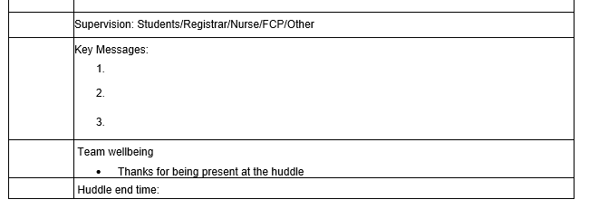

Slide 18
Standard format
Set time and location
Standard operating procedures
Keep them brief
Think about participants
Notes:
Establish a set location and time.
Consider if it is necessary to complete a team huddle every day. Perhaps you can run the huddles every other day or less frequently and they will still be effective.
Keep in mind, the amount of days you decide to have a team huddle does not and should not be set in stone. As we have seen the frequency might be different during different circumstances.
Have standard operating procedures, think about who will facilitate the huddle, how you will ensure everybody has a chance to speak, how you will provide feedback to those you aren’t able to attend, for example will a colleague provide feedback, will meeting notes or a checklist be shared, will key messages be emailed etc.
Make them brief – 5 to 10 minutes and 15 minutes tops. Generally, standing up will help keep meetings short and to the point, because let’s be honest – who wants to stand for over 15 minutes?
Think about who will attend, know when to make them multi-disciplinary or uni-disciplinary and think about how you will share any information with those unable to attend in person. In practices most huddles are likely to be multi-disciplinary, however If you have a lot of employees, it might be smart to have a couple huddles at specified times that focus on specific departments. Is attendance mandatory, if you are in the practice. Are numbers currently restricted due to social distancing.

Slide 19
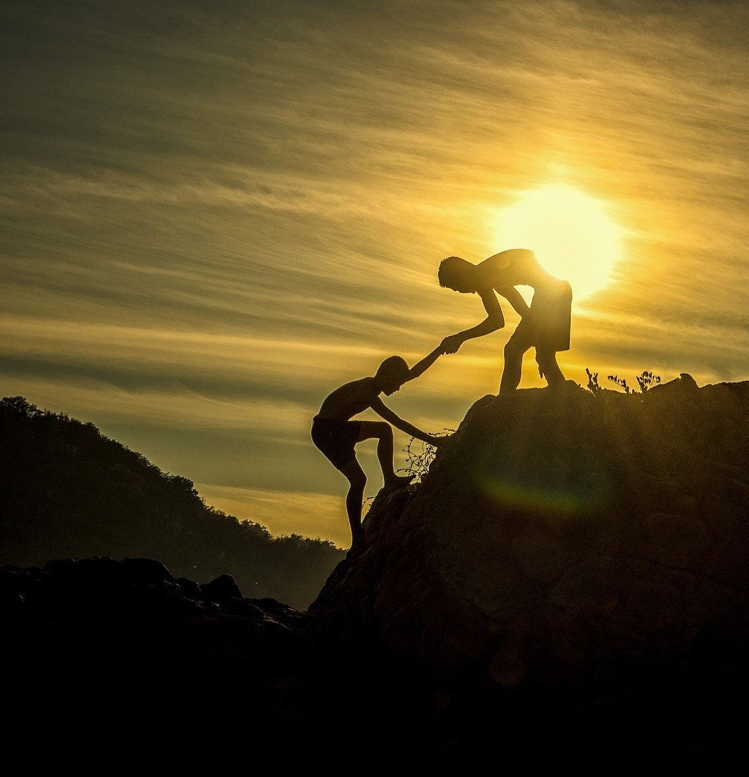
Getting people to stop
Yet another meeting!!
Difficult to demonstrate benefits
Getting off topic
Notes:
There are of course some challenges
Getting everyone to stop what they are doing and gather into a huddle is initially a challenge and with so many meetings happening, participants may view the huddle as yet another meeting, that takes you away from patients or your job, keeping the meeting short and relevant will help with this, as will demonstrating the benefits of huddling
These benefits are not always easy to demonstrate – think about how you will demonstrate how useful a huddle is, staff survey, anecdotal evidence, feedback of changes the practice has made and so on
Your team huddle is not the time to plan projects, solve projects, or negotiate. Problem solving requires debate, discussion, and a thorough review of all options. In other words, it requires time! Since your morning huddle should be fairly short, you should schedule a separate meeting with the team members concerned.
Try not to get off topic and focus on the things that are important by having some sort of sign. It could be as simple as nicely saying let’s move on, but head into my office later so we can talk about this more.

Slide 20
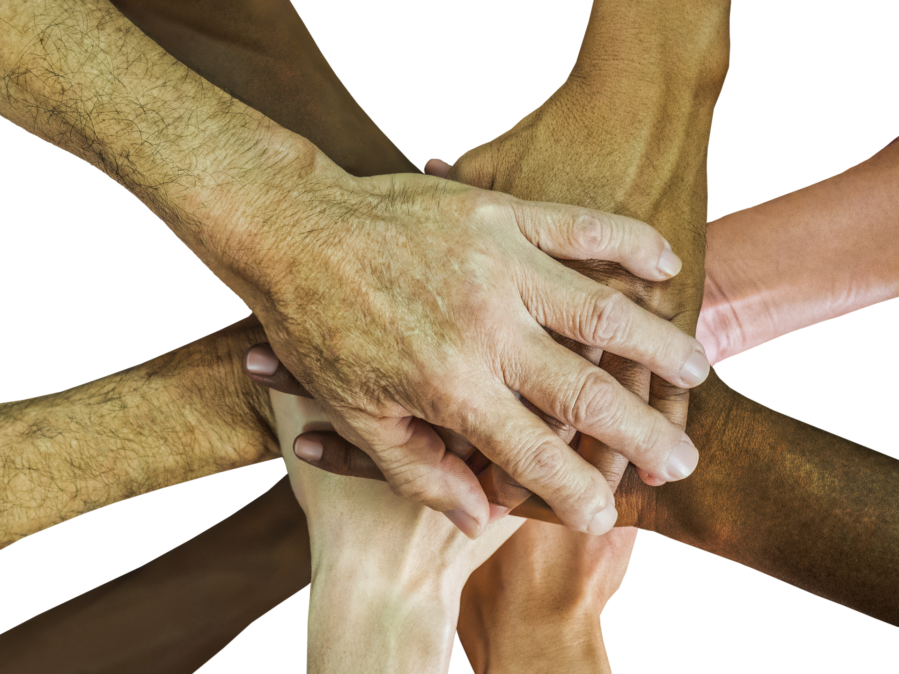
Notes:
That’s very much a whistle stop tour of huddles and some of the benefits practices have seen from using them.
I’ve seen a huddle described as the most important meeting of your day and I think it’s easy to see why they may well be.
If you would like more information then please do get in touch my details are.

Slide 21
tracey.crickett@nhs.scot
https://www.scotlanddeanery.nhs.scot/your-development/practice-manager-development/
Notes:
Thank you

