Slide 1
Applying for a CESR
NES – 30 May 2019
Rose Jackson
Specialist Applications Team Coordinator

Slide 2
Applying for a CESR – workshop objectives
Introduction to the Specialist Applications Team
General overview of CESR
Future of CESR
Group session – what makes a strong CESR?
Group session – Q&A

Slide 3
What do the Specialist Applications Team do?
Manage all applications for entry onto the Specialist or GP Register:
Certificate of Completion of Training (CCT)
Certificate of Eligibility for Specialist Registration (CESR)
Certificate of Eligibility for General Practice Registration (CEGPR)
Verifications and duplicates of certificates issued by GMC and predecessors
Coordinate GMC’s response to appeals against Specialist or GP Registration
Applications for Out of Programme (OOP) approval
Notes:
Receive approx. 6.5-7k CCTs p/a (5% of time)
Receive approx. 750-800 CESR p/a (95% of time)

Slide 4
What’s a CESR?
Entry onto the Specialist Register with a Certificate of Eligibility for Specialist Registration (CESR)
Route for doctors who haven’t followed full training programme in the UK
Assessed against standards of the UK CCT curriculum
Evidence based application process
CESR is not
An assessment of competency in your current role
Based solely on recommendations from colleagues
Notes:
Received 750+ CESR in 2018; 680 2017

Slide 5
CESRs received by specialty

Slide 6
How am I eligible for a CESR?
To be eligible for a CESR application, you must have either:
A specialist medical qualification in the specialty you are applying
or
At least 6 months continuous training in the specialty you are applying
The above can be from any point in your career and anywhere in the world
You must provide documentary evidence of eligibility

Slide 7
How do I apply for a CESR?
Applications are made through GMC Online
Electronic evidence can be uploaded
Once you’ve started an application, you must submit it within 12 months
Current CESR fee: £1,640

Slide 8
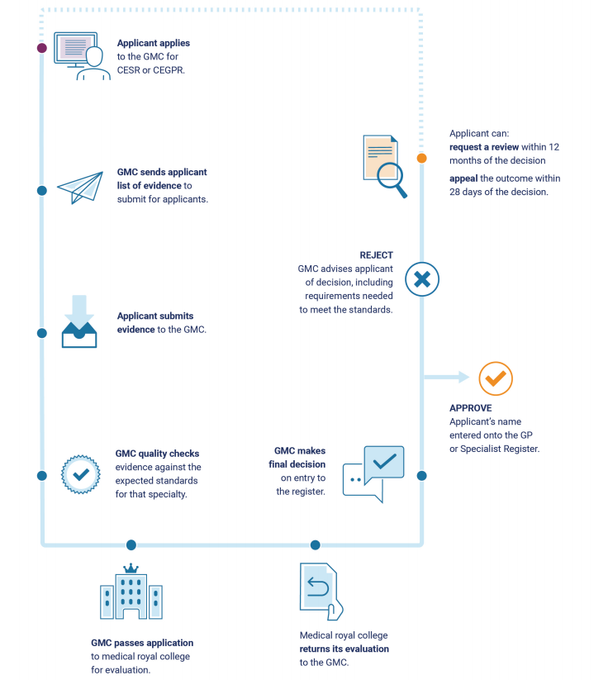
The CESR process

Slide 9
How do I get my evidence verified?
Verifier
Proforma
Review
Submit
PSV
Identify a verifier from each institution
Complete the proforma
Verifier to check evidence
Submit proformas with application evidence
GMC conducts primary source verification (PSV)

Slide 10
How do I submit electronic evidence?
Evidence can be uploaded for each section of the application
Portfolio-style application
Applications Advisers can share guidance electronically
Faster, cheaper, and more secure
What can I upload?
.pdf
.doc
.ppt
.xls
We recommend that you upload your evidence in PDF format

Slide 11
Before you apply…
Read the specialty specific guidance (SSG) and curriculum for your specialty
Make sure you’ve collated all required evidence
Don’t duplicate evidence
Make sure your evidence is relevant
Bear in mind that CESR applications are typically 800-1200 pages
Make sure all your evidence is anonymised

Slide 12
CESR stage 1 – initial assessment
Eligibility check
Request structured reports
Contact verifiers

Slide 13
Structured reports
Minimum of 4 referees
Structured reports used to triangulate your primary evidence
Referees must be able to comment on your current/recent competence and breadth of your practice
2 referees should work in your specialty
First referee must be your current clinical / medical director

Slide 14
CESR stage 2 – evidence review
Application adviser reviews evidence
Guidance provided on how application could be strengthened
60 days to submit additional evidence

Slide 15
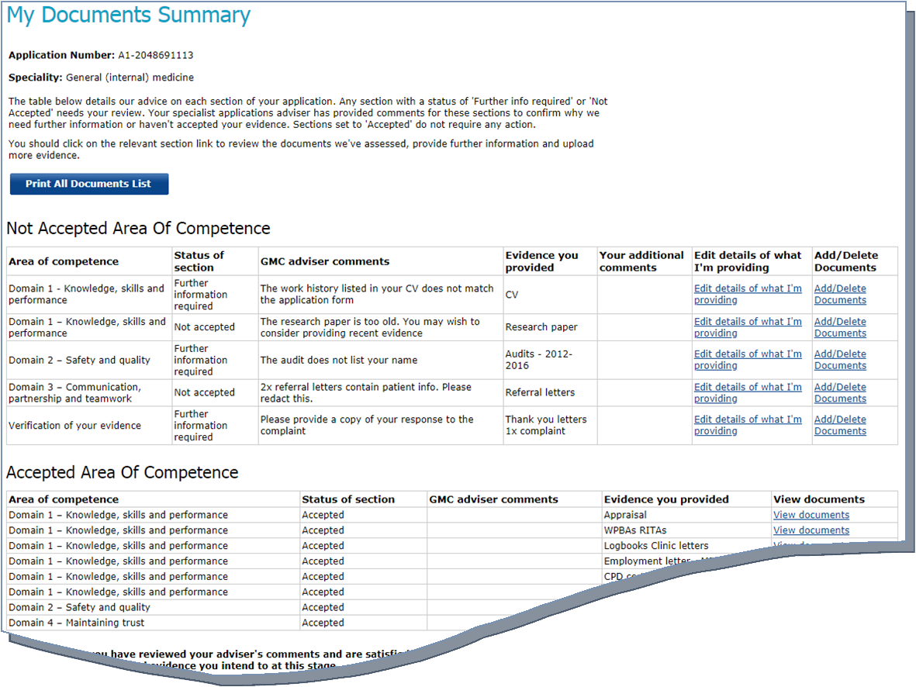
CESR evidence – application adviser’s guidance

Slide 16
CESR stage 3 – evaluation of your application
Royal College / Faculty provide specialist assessment
Two independent evaluators
GMC undertake a quality assurance review
GMC issues decision based on the RCF recommendation

Slide 17
CESR success rates

Slide 18
Why are applications unsuccessful?
No evidence demonstrating level of competence / performance (WPBAs)
Haven’t passed the standard test of knowledge within the curriculum or demonstrated equivalent
Insufficient evidence of audits – particularly closing the loop
Lack of research evidence
Specialisation in one area of the curriculum
Lack of management / leadership experience

Slide 19
What if I’m unsuccessful?
Provided with a series of recommendations from RCF
Two options:
Apply for a Review
Appeal the decision
Review
Apply on basis of additional evidence or if you feel there’s been a procedural error
Must apply within 12 months
Only provide evidence to meet recommendations
£712
Appeal
Decision made by the GMC not to include you on SR or GPR
£1,640 - £2,480

Slide 20
Review application success rates

Slide 21
The future of CESR
New standards for curricula development launched in 2017
All Royal Colleges and Faculties must update their curricula to incorporate Generic Professional Capabilities (GPCs) by the end of 2020
CESR/CEGPR applicants are assessed against relevant CCT curriculum
Incorporating GPCs will change the structured of the curricula; thus structure of CESR
If you’ve started an application, we’ll keep you updated on the progress of curriculum development in your specialty

Slide 22
Contacting us
0161 923 6602
equivalence@gmc-uk.org
www.gmc-uk.org

