Slide 1
Applying for Specialist Registration through the CESR Route
Richard Filby
Specialist Applications Team Coordinator

Slide 2
Welcome
Introduction to GMC team
Presentation
Break into groups
Group work with Specialist Applications Adviser
Feedback

Slide 3
What is a CESR
Entry onto the Specialist Register with a Certificate of Eligibility for Specialist Registration (CESR)
It is a route for doctors who have not followed a full UK training programme (CCT)
Notes:
3

Slide 4
Eligibility in a CCT specialty
To be eligible to apply for a CESR in a CCT specialty you must have:
6 months continuous training in the speciality in which you are applying, undertaken anywhere in the world
OR
A Specialist Medical Qualification in the speciality in which you are applying, obtained anywhere in the world
Notes:
4

Slide 5
How to apply and cost
All applications can be made on line via GMC Online.
A CESR application is £1,600 – payable at the point the application is submitted.
Notes:
5

Slide 6
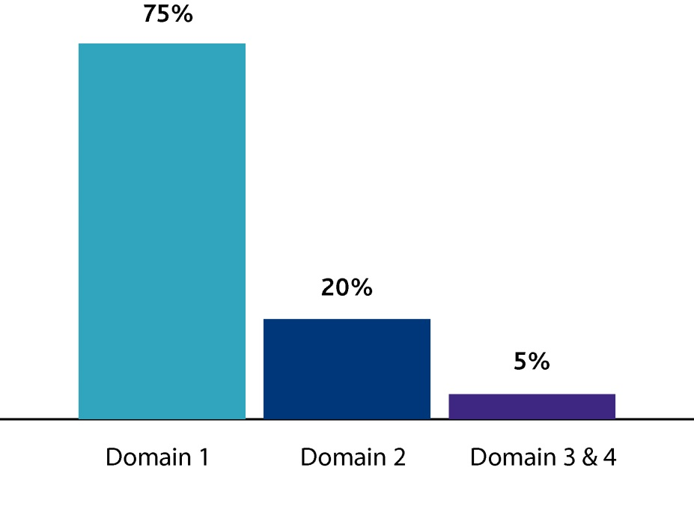
Preparing for submission
Documentary evidence based on GMC’s Good Medical Practice Guide:
Domain 1: Knowledge, skills and performance
Domain 2: Safety and quality
Domain 3: Communication, partnership and teamwork
Domain 4: Maintaining trust
Notes:
6

Slide 7
Preparing for submission
Read the Specialty Specific Guidance – SSG
If you don’t have the evidence, wait until you can get it
Bundles are typically 800-1000 pages long
No need to duplicate evidence
Make sure your evidence is relevant

Slide 8
Evidence - Authentication
Registration or Qualifications obtained outside the UK
Authentication by a Solicitor or the Awarding Body
They stamp and sign a copy – to certify they have seen the original
Also known as a Certified Copy
Notes:
8

Slide 9
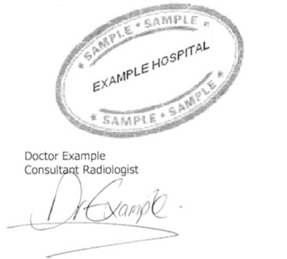
Evidence - Validation
Every piece of evidence that relates to your training and experience
Medical Supervisors who can confirm it is a true and accurate record
Hospital Stamp
Name of person validating
Their job title
Their Signature
Incorrectly validated or authenticated evidence will not be sent to the Royal College of Faculty
Notes:
9

Slide 10
Structured Reports
You will be asked to provide 6 referees
The Royal College/Faculty uses them to triangulate your primary evidence
Verify work, training and experience
Details on your personal attributes, skills and competencies
First referee should be your current medical / clinical director
Notes:
10

Slide 11
What happens once you have applied?
You will be allocated a Specialist Applications Adviser who will contact you when we receive your evidence.
They will undertake an initial assessment based on the information you have provided.
Request your structured reports.
Notes:
11

Slide 12
What happens next?
We will expect to receive your evidence bundle within 14 days of receiving your application.
We then have 30 days to provide you with a checklist.
Checked against the SSG and Curriculum to identify gaps.
You then have a further 60 days to submit any further evidence.
Notes:
12

Slide 13
What happens next?
After 60 days your application is deemed closed.
It is uploaded to the Royal College/Faculty for evaluation.
We have 3 months to issue a decision.
Internal Quality Assurance process prior to decisions being issued.
Notes:
13

Slide 14
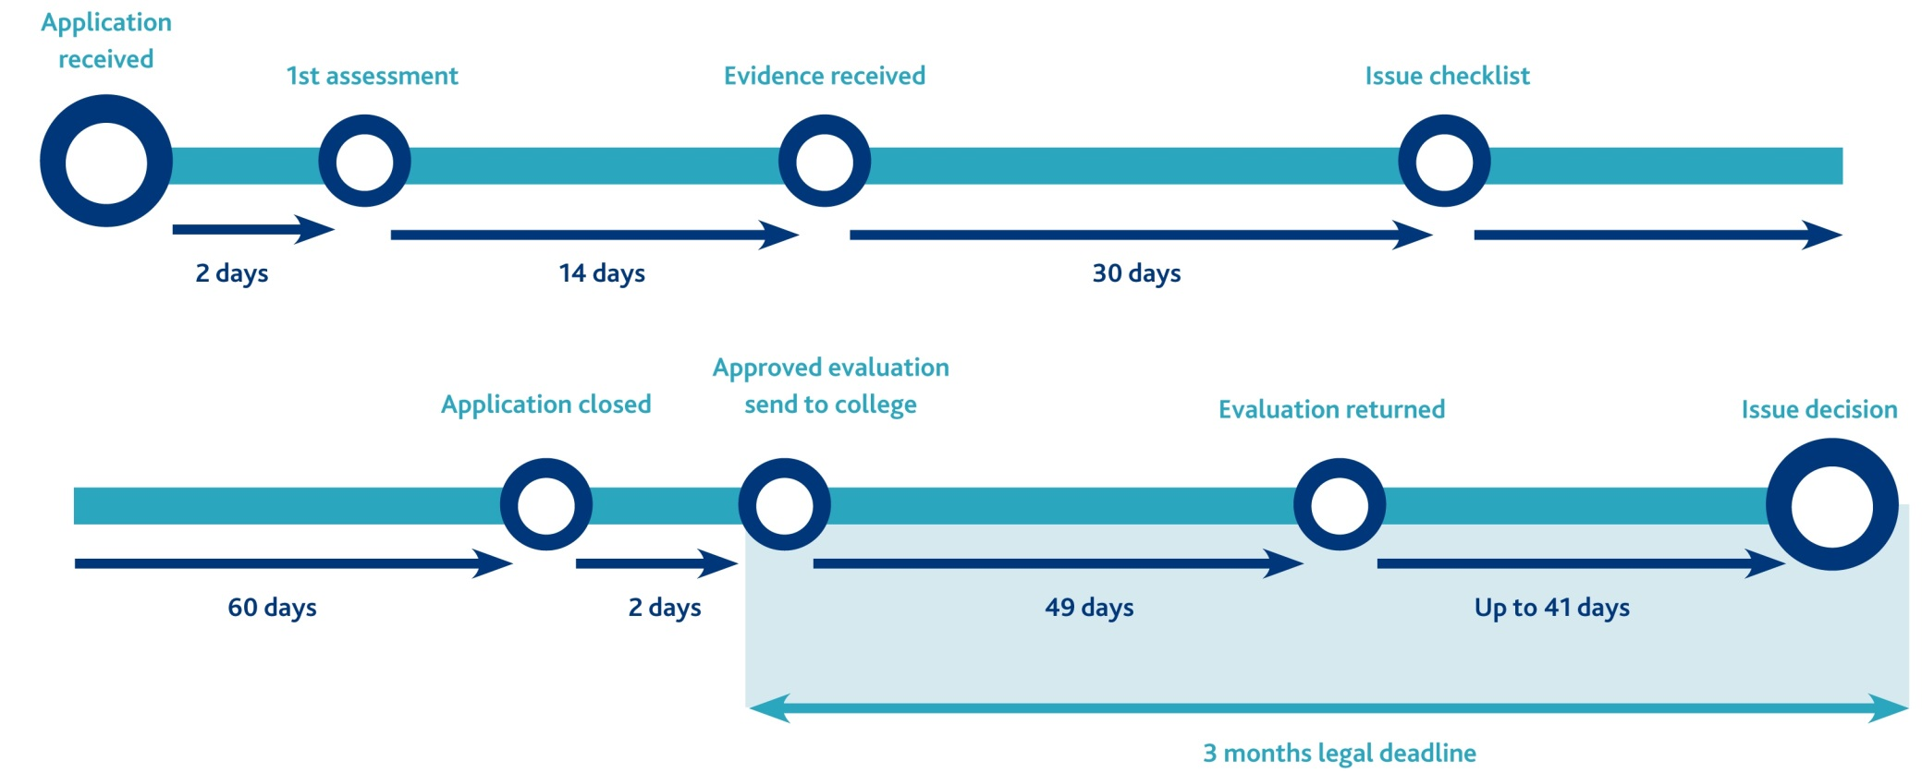
The CESR application process

Slide 15
A decision is made - Successful
Specialist Registration is automatically granted.
A copy of the evaluation is sent to you.
Notes:
15

Slide 16
A decision is made - Unsuccessful
A letter confirming you have not been successful
A copy of the evaluation
Recommendations which will help in future applications
Notes:
16

Slide 17
Review
You may ask us to review our decision on an unsuccessful application if:
You have additional relevant documentary evidence
OR
You consider there has been a procedural error
You have 12 months to submit a review application from the date on your decision letter. The fee for a review application is £695.
Notes:
17

Slide 18
Success Rates
Success depends on:
Your past experience and training
The evidence you provide
Your willingness to engage
The following statistics are not an indication of your likelihood of success
Notes:
18

Slide 19
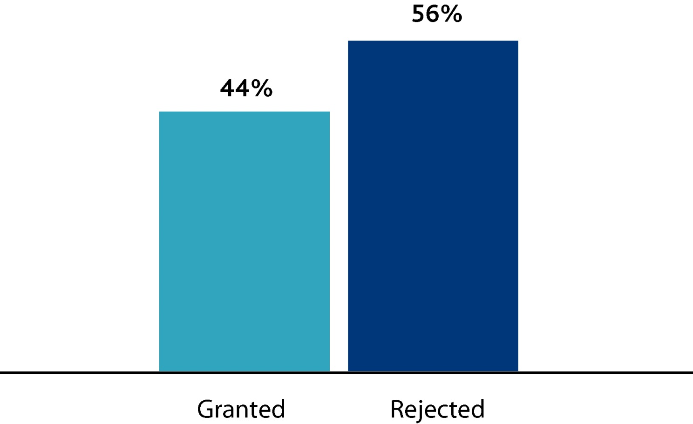
Success rates
Notes:
19

Slide 20
For more help from the Specialist Applications Team
ü
Website
www.gmc-uk.org
*
Email
equivalence@gmc-uk.org
(
Phone
0161 923 6602
Notes:
20

Slide 21
Group Exercises
Split into groups
Practical tips on preparing for submission
Q&A session with Specialist Applications Adviser
Note: discussion is about the theory and not content

